Slide 1

Interpolation and Approximation with Python

Slide 2
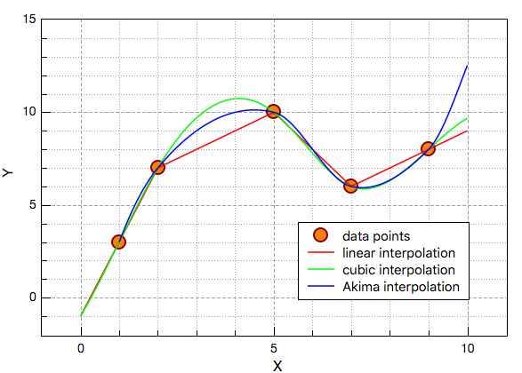
The Interpolation Problem
Given a set of n+1 points,
Find an n^{th} order polynomial
that passes through all points, such that:

Slide 3
Existence and Uniqueness
Given a set of n+1 points:
Assumption: are distinct
Theorem:
There is a unique polynomial f_{n}(x) of order ≤ n such that:
There is one and only one nth-order polynomial that fits n+1 points

Slide 4
Examples of Polynomial Interpolation
Linear Interpolation
Given any two points, there is one polynomial of order ≤ 1 that passes through the two points.
Quadratic Interpolation
Given any three points there is one polynomial of order ≤ 2 that passes through the three points.

Slide 5


Interpolation
Interpolation is used to estimate data points between two known points
Known points
?
?
?
The most common interpolation technique is Linear Interpolation.
Others are Quadratic, Cubic, … (Splines)

Slide 6
Interpolation
We can use the following packages:
numpy.interp
https://docs.scipy.org/doc/numpy/reference/generated/numpy.interp.html
scipy.interpolate
https://docs.scipy.org/doc/scipy/reference/tutorial/interpolate.html
y_new = np.interp(x_new, x, y)
f = interpolate.interp1d(x, y)

Slide 7
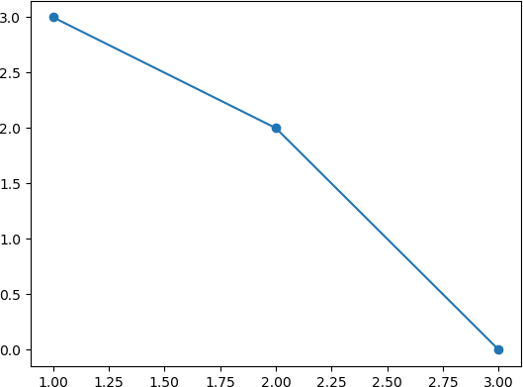
Interpolation - Example
We can plot the data points like this:
Assume the following Data:
𝑥 | 𝑦
1 | 3
2 | 2
3 | 0
𝑦
Assume we want to find the value for
𝑦 when 𝑥 = 2.5
From the plot we see that 𝑦 = 1 is a good guess
𝑥

Slide 8



Interpolation - Example
Python Code:
import numpy as np import matplotlib.pyplot | as | plt
x = [1, 2, 3] y = [3, 2, 0]
x_new = 2.5
y_new = np.interp(x_new, | x, | y)
One-dimensional linear interpolation for monotonically increasing sample points.
print("New Interpolated Value:") print(y_new)
plt.plot(x,y,'o-') plt.show()
New Interpolated Value: 1.0

Slide 9



Linear vs Cube Interpolation
import numpy as np
import matplotlib.pyplot as plt
from scipy.interpolate import interp1d
We start with a cos function and compare Linear and Cubic
interpolation
x = np.linspace(0, 10, num=11, endpoint=True) y = np.cos(-x**2/9.0)
f = interp1d(x, y) #linear is default
f2 = interp1d(x, y, kind='cubic')
xnew = np.linspace(0, 10, num=41, endpoint=True)
plt.plot(x, y, 'o', xnew, f(xnew), '-*', xnew, f2(xnew), '--*')
plt.legend(['data', 'linear', 'cubic'], loc='best') plt.show()

Slide 10
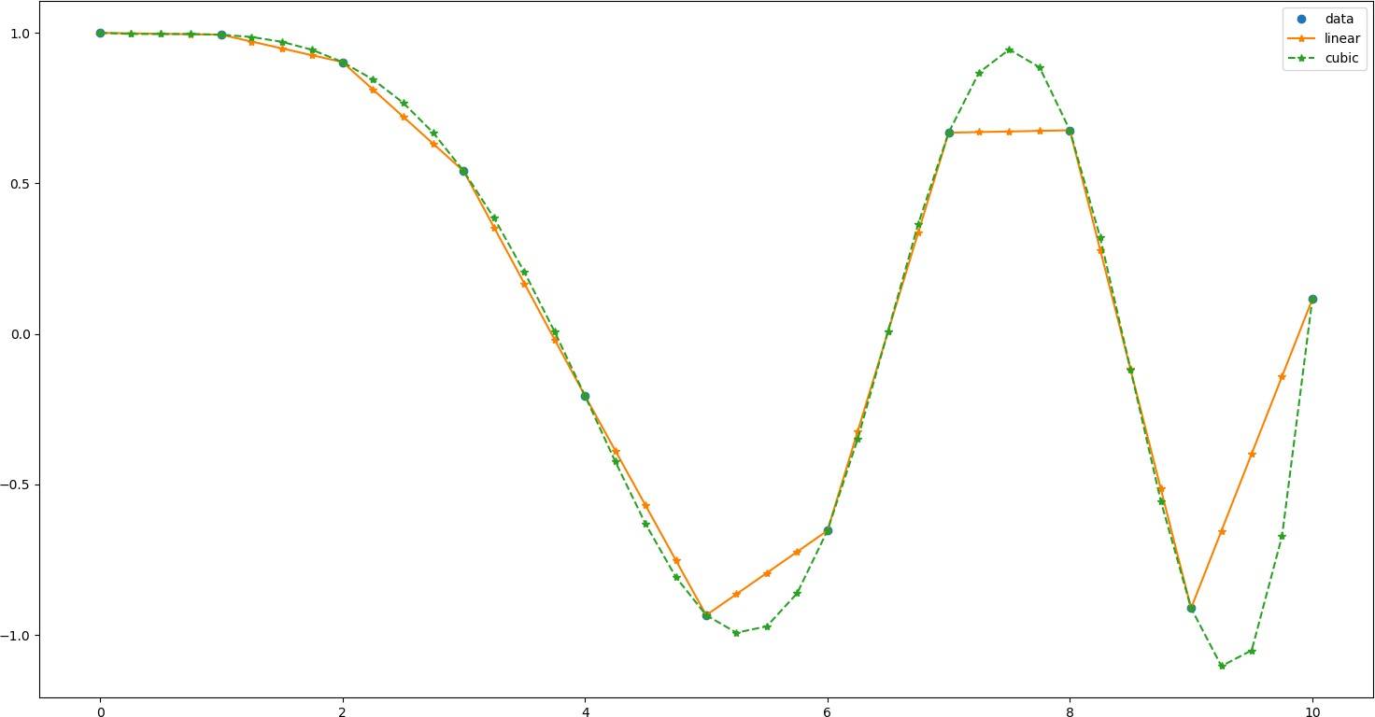
Linear vs Cube cont.
From Figure we see that the cubic interpolation gives a good results based on the cosine function we used in this example.

Slide 11
Newton’s Divided Differences

Slide 12
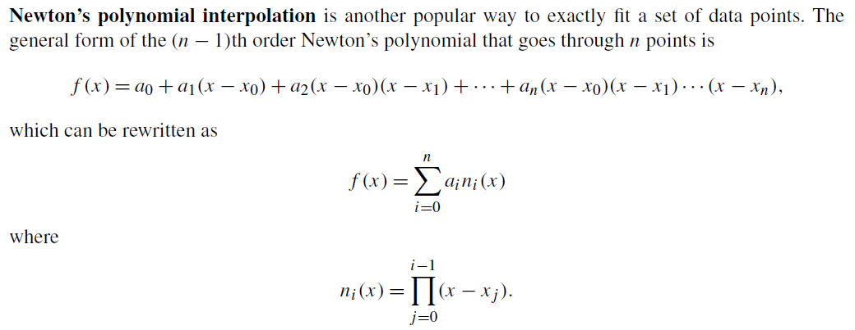
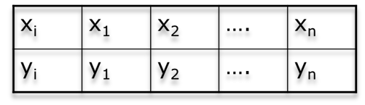
NEWTON’S POLYNOMIAL
-1⁾

Slide 13
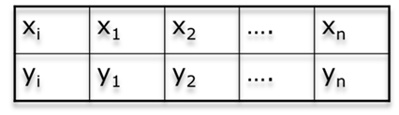
NEWTON’S POLYNOMIAL
-1⁾

Slide 14
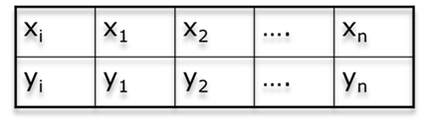
NEWTON’S POLYNOMIAL
-1⁾

Slide 15
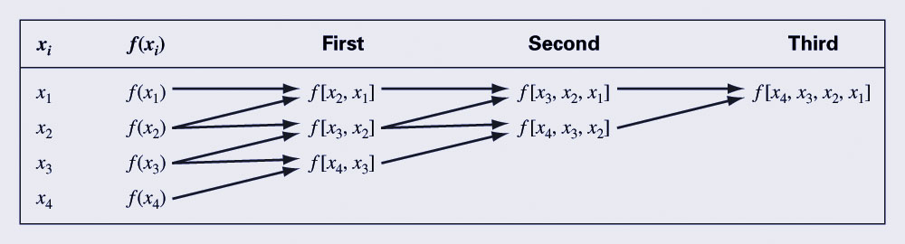
Divided Difference Table
Divided difference are calculated as follows:
Divided differences are calculated using divided difference of a smaller number of terms:
15

Slide 16

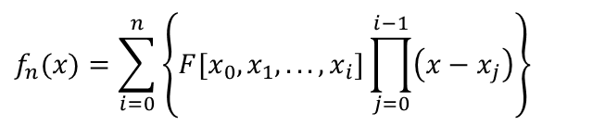


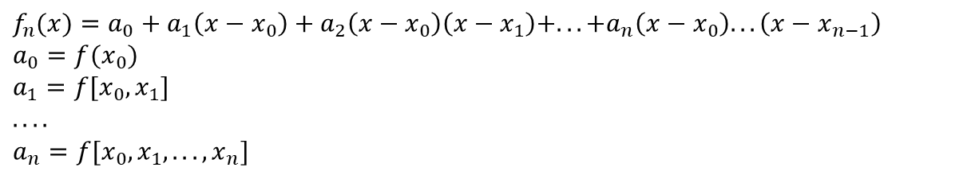

Divided Difference Table
x | f[ ] | f[ , ] | f[ , , ] | f[ , , ,]
x₀ | f[x₀] | f[x₀,x₁] | f[x₀,x_{1,}x₂] | f[x₀,x₁,x₂,x₃]
x₁ | f[x₁] | f[x₁,x₂] | f[x₁,x₂,x₃]
x₂ | f[x₂] | f[x₂,x₃]
x₃ | f[x₃]
$${=a}_{0}$$
$${=a}_{1}$$
$${=a}_{2}$$
$${=a}_{3}$$
$$f_{n}(x)=\sum_{i=0}^{n}{\left\{F[x_{0},x_{1},...,x_{i}]\prod_{j=0}^{i−1}{\left(x−x_{j}\right)}\right\}}$$
$$f_{n}(x)=a_{0}+a_{1}\left(x−x_{0}\right)+a_{2}\left(x−x_{0}\right)\left(x−x_{1}\right)+...+a_{n}\left(x−x_{0}\right)...\left(x−x_{n−1}\right) \\ a_{0}=f(x_{0}) \\ a_{1}=f[x_{0},x_{1}] \\ .... \\ a_{n}=f[x_{0},x_{1},...,x_{n}]$$

Slide 17
Divided Difference Table
x | f[ ] | f[ , ] | f[ , , ]
0 | -5 | 2 | -4
1 | -3 | 6
-1 | -15
 | f(x_{i})
0 | -5
1 | -3
-1 | -15
Entries of the divided difference table are obtained from the data table using simple operations.

Slide 18
Divided Difference Table
x | f[ ] | f[ , ] | f[ , , ]
0 | -5 | 2 | -4
1 | -3 | 6
-1 | -15
 | f(x_{i})
0 | -5
1 | -3
-1 | -15
The first two column of the
table are the data columns.
Third column: First order differences.
Fourth column: Second order differences.

Slide 19
Divided Difference Table
0 | -5
1 | -3
-1 | -15
x | f[ ] | f[ , ] | f[ , , ]
0 | -5 | 2 | -4
1 | -3 | 6
-1 | -15

Slide 20
Divided Difference Table
0 | -5
1 | -3
-1 | -15
x | f[ ] | f[ , ] | f[ , , ]
0 | -5 | 2 | -4
1 | -3 | 6
-1 | -15

Slide 21
Divided Difference Table
0 | -5
1 | -3
-1 | -15
x | f[ ] | f[ , ] | f[ , , ]
0 | -5 | 2 | -4
1 | -3 | 6
-1 | -15

Slide 22
Divided Difference Table
0 | -5
1 | -3
-1 | -15
x | f[ ] | f[ , ] | f[ , , ]
0 | -5 | 2 | -4
1 | -3 | 6
-1 | -15
f₂(x)= f[x₀]+f[x₀,x₁] (x-x₀)+f[x₀,x₁,x₂] (x-x₀)(x-x₁)

Slide 23
Two Examples
Obtain the interpolating polynomials for the two examples:
x | y
1 | 0
2 | 3
3 | 8
x | y
2 | 3
1 | 0
3 | 8
What do you observe?

Slide 24
Two Examples
x | Y
1 | 0 | 3 | 1
2 | 3 | 5
3 | 8
x | Y
2 | 3 | 3 | 1
1 | 0 | 4
3 | 8
Ordering the points should not affect the divided difference:

Slide 25
Example
Find a polynomial to interpolate the data.
x | f(x)
2 | 3
4 | 5
5 | 1
6 | 6
7 | 9

Slide 26

Example
x | f(x) | f[ , ] | f[ , , ] | f[ , , , ] | f[ , , , , ]
2 | 3 | 1 | -1.6667 | 1.5417 | -0.6750
4 | 5 | -4 | 4.5 | -1.8333
5 | 1 | 5 | -1
6 | 6 | 3
7 | 9

Slide 27
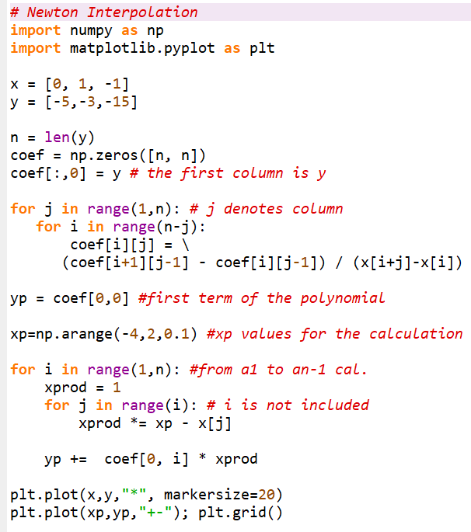
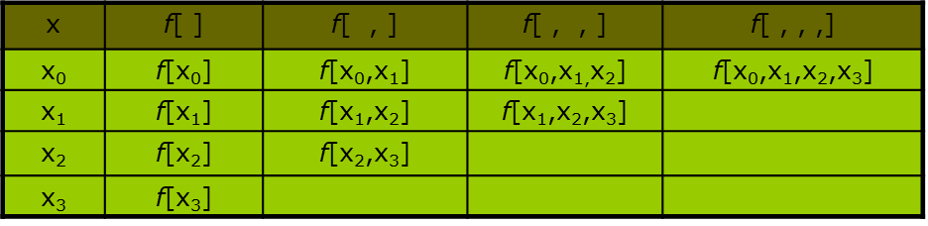

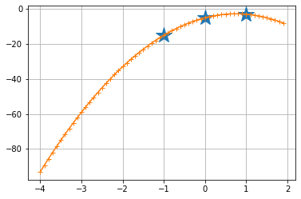
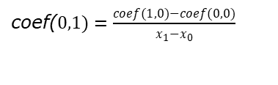
coef($0,1)=\frac{coef(1,0)−coef(0,0)}{x_{1}−x_{0}}$

Slide 28
Lagrange Interpolation

Slide 29
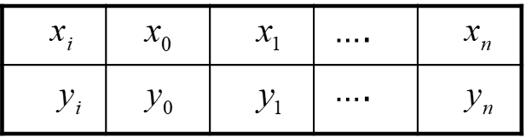
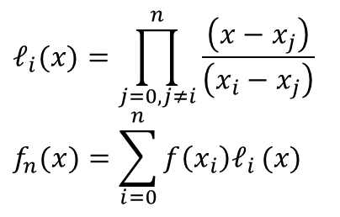
Lagrange Interpolation
Lagrange polynomial interpolation finds a single polynomial that goes through all the data points. This polynomial is referred to as a Lagrange polynomial, L(x).
As an interpolation function, it should have the property L(xi ) = yi for every point in the dataset.
When computing Lagrange polynomials, it is useful to write them as a linear combination of Lagrange basis polynomials, Pi(x), where
$$ℓ_{i}(x)=\prod_{j=0,j≠i}^{n}{\frac{\left(x−x_{j}\right)}{\left(x_{i}−x_{j}\right)}}$$
$$f_{n}(x)=\sum_{i=0}^{n}{f\left(x_{i}\right)ℓ_{i}}(x)$$

Slide 30
Lagrange Interpolation
Problem:
Given
Find the polynomial of least order such that:
Lagrange Interpolation Formula:
 |  |  | ….
 |  |  | ….

Slide 31
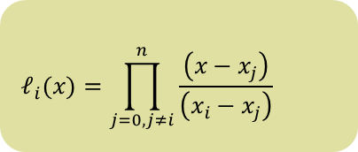
Lagrange Interpolation Example
x | 1/3 | 1/4 | 1
y | 2 | -1 | 7
$$ℓ_{i}(x)=\prod_{j=0,j≠i}^{n}{\frac{\left(x−x_{j}\right)}{\left(x_{i}−x_{j}\right)}}$$

Slide 32
Example
Find a polynomial to interpolate:
Both Newton’s interpolation method and Lagrange interpolation method must give the same answer.
x | y
0 | 1
1 | 3
2 | 2
3 | 5
4 | 4

Slide 33
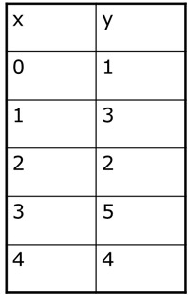

Interpolating Polynomial Using Lagrange Interpolation Method
$$ℓ_{i}(x)=\prod_{j=0,j≠i}^{n}{\frac{\left(x−x_{j}\right)}{\left(x_{i}−x_{j}\right)}}$$

Slide 34
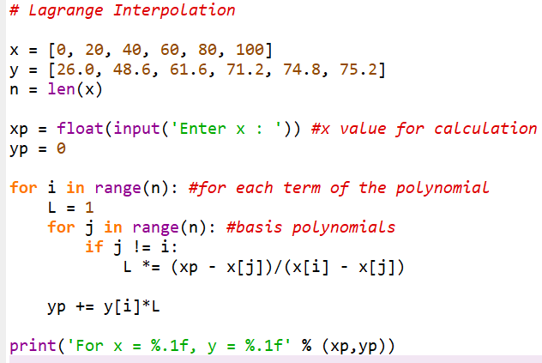

Code

Slide 35
Interpolation using spline functions

Slide 36
Why Splines ?

Slide 37
Why Splines ?
Figure : Higher order polynomial interpolation is a bad idea

Slide 38
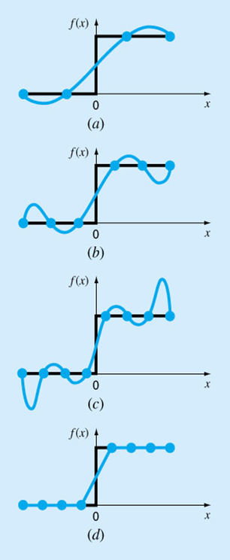
Spline Interpolation
There are cases where polynomials can lead to erroneous results because of round off error and overshoot.
Alternative approach is to apply lower-order polynomials to subsets of data points. Such connecting polynomials are called spline functions.

Slide 39
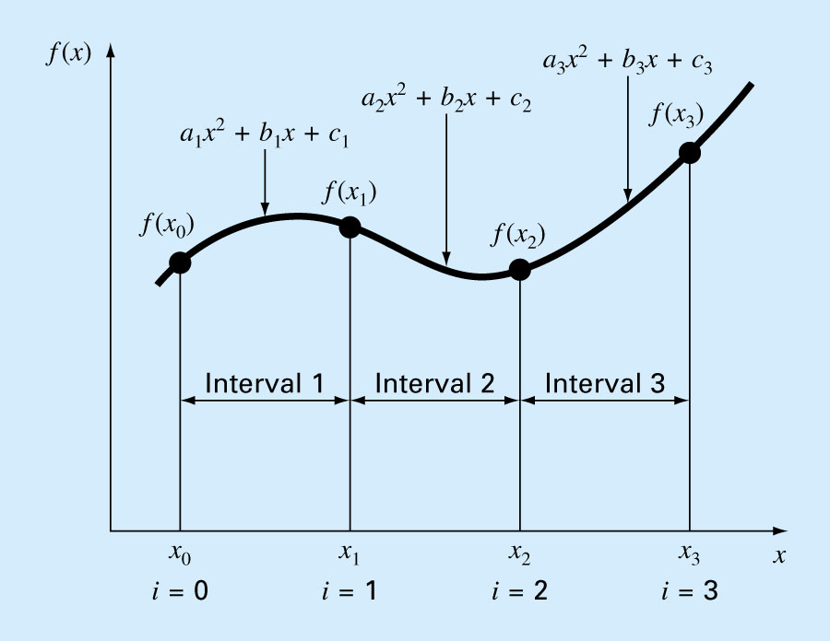
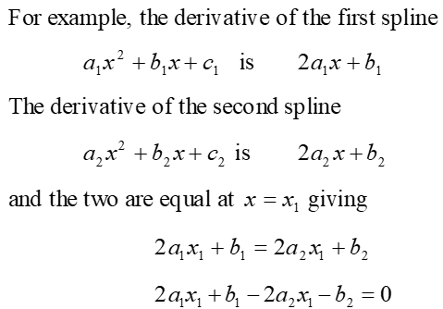
Spline Interpolation
Alternative approach is to apply lower-order polynomials to subsets of data points.
“n” is the number of equations
There are 3*n unknowns

Slide 40
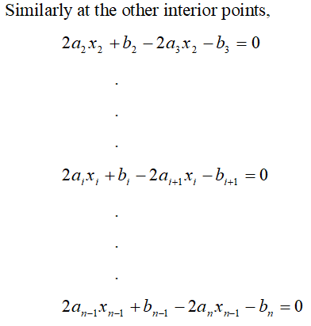
Quadratic Splines (contd)
“n” is the number of equations
“n-1” equations can be defined for the solution

Slide 41
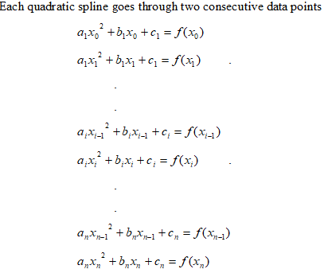
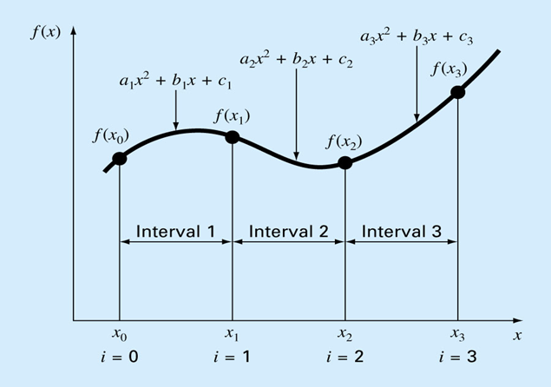
Quadratic Interpolation (contd)

Slide 42
Quadratic Splines (contd)
f
(
x
=
2
+
+
≤
≤
)
a
x
b
x
c
,
x
x
x
1
1
1
0
1
=
a
2
+
+
≤
≤
x
b
x
c
,
x
x
x
2
2
2
1
2
.
.
.
=
a
2
+
+
≤
≤
x
b
x
c
,
x
−
x
x
n
n
n
n
1
n

Slide 43
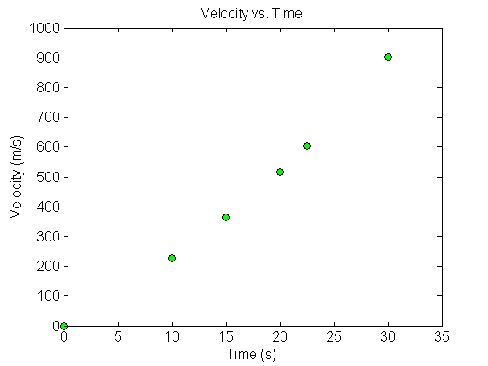
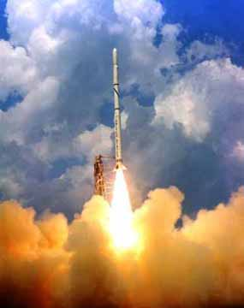
Quadratic Spline Example
The upward velocity of a rocket is given as a function of time. Using quadratic splines
Find the velocity at t=16 seconds
Find the acceleration at t=16 seconds
Find the distance covered between t=11 and t=16 seconds
Table Velocity as a
function of time
(s) | (m/s)
0 | 0
10 | 227.04
15 | 362.78
20 | 517.35
22.5 | 602.97
30 | 901.67
Figure. Velocity vs. time data
for the rocket example
Notes:
43

Slide 44
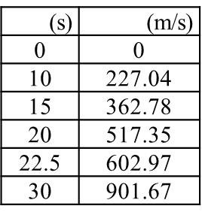
Solution
Let us set up the equations
Notes:
44

Slide 45
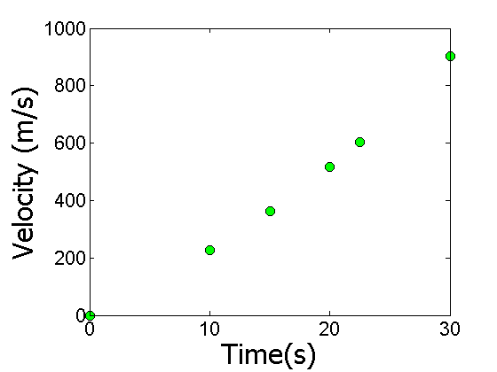
Each Spline Equation Goes Through Two Consecutive Data Points
(s) | (m/s)
0 | 0
10 | 227.04
15 | 362.78
20 | 517.35
22.5 | 602.97
30 | 901.67
Notes:
45

Slide 46
Each Spline Goes Through Two Consecutive Data Points
t | v(t)
s | m/s
0 | 0
10 | 227.04
15 | 362.78
20 | 517.35
22.5 | 602.97
30 | 901.67
3th equ.
4th equ.
Notes:
46

Slide 47
Derivatives are Continuous at Interior Data Points
Notes:
47

Slide 48
Derivatives are continuous at Interior Data Points
At t=10
At t=15
At t=20
At t=22.5
Notes:
48

Slide 49
Last Equation

Slide 50
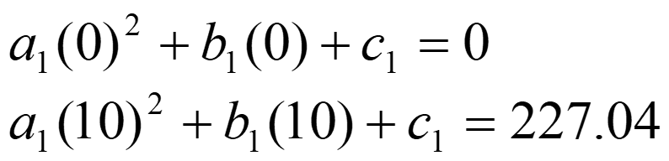
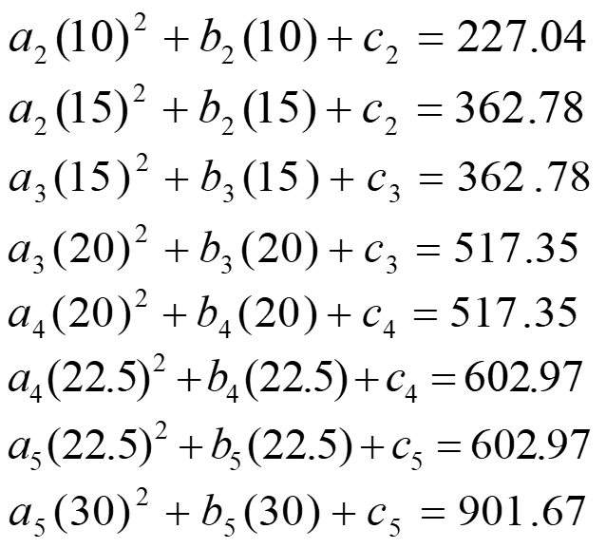
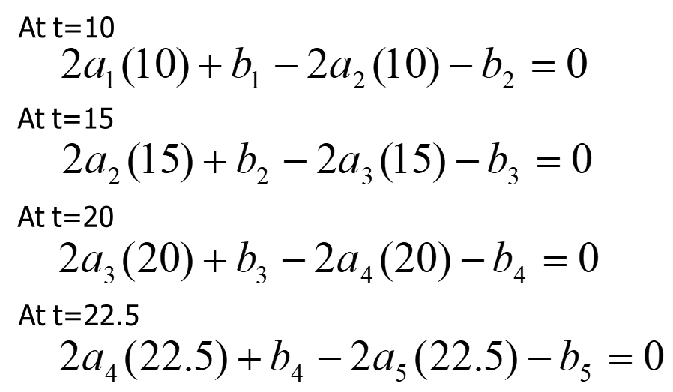
Final Set of Equations
Notes:
50

Slide 51
Coefficients of Spline
i | a_{i} | b_{i} | c_{i}
1 | 0 | 22.704 | 0
2 | 0.8888 | 4.928 | 88.88
3 | −0.1356 | 35.66 | −141.61
4 | 1.6048 | −33.956 | 554.55
5 | 0.20889 | 28.86 | −152.13
Notes:
51

Slide 52
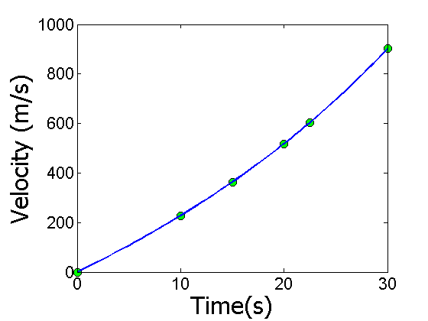
Final Solution
Notes:
52

Slide 53
Velocity at a Particular Point
a) Velocity at t=16

